Slide 1
Let’s start…

Slide 2

WELCOME
Project Presentation
Department of Computer Science and Engineering, DUET.
Project Name: Discount Management for a Saloon by CPP
Presented by :
Md. Taufik Hasan
CSE 2/1
ID : 194095

Slide 3


Project Selection:
My Student ID is 194095. So, last 3 digits of my ID is 095 mode by 20. Reminder is 15 now addition 1 with this reminder. So, My Project number is 16.
Project Number 16: You are asked to write a discount system for a saloon, which provides service and sells beauty products. It offers 3 types of memberships Premium, Gold and Silver members receive a discount of 20%,15% and 10% respectively. For all services provided customers without memberships receives no discount. All members receive a flat 10% discount on product purchased (that might change in future)

Slide 4
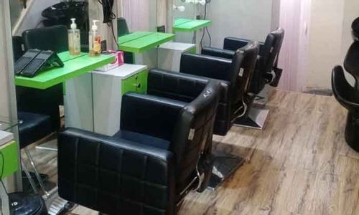
Project Selection:
My Student ID is 194095. So, last 3 digits of my ID is 095 mode by 20. Reminder is 15 now addition 1 with this reminder. So, My Project number is 16.
Project Analysis:
This project for a Saloon Discount system that provides services and sells beauty products. So firstly, we need to store those available services and products for saloon serves customers. So, we have needed two separate classes for services and beauty products which required member variables and functions. Now focus on customers membership, every customer is a member, So we need a class member then we separate members to different memberships like as Premium, Gold, Silver and General member. This all-different membership is a separate class that contains different discount percentages. All Products are under a flat discount offer which will be changeable.
Project Number 16: You are asked to write a discount system for a saloon, which provides service and sells beauty products. It offers 3 types of memberships Premium, Gold and Silver members receive a discount of 20%,15% and 10% respectively. For all services provided customers without memberships receives no discount. All members receive a flat 10% discount on product purchased (that might change in future)
A

Slide 5
Project Selection:
My Student ID is 194095. So, last 3 digits of my ID is 095 mode by 20. Reminder is 15 now addition 1 with this reminder. So, My Project number is 16.
Membership criteria
Project Analysis:
If a member deposits 7,000 BDT, then he gets Premium membership. When he purchased a service, he gets 20% discount on that service's price.
This project for a Saloon Discount system that provides services and sells beauty products. So firstly, we need to store those available services and products for saloon serves customers. So, we have needed two separate classes for services and beauty products which required member variables and functions. Now focus on customers membership, every customer is a member, So we need a class member then we separate members to different memberships like as Premium, Gold, Silver and General member. This all-different membership is a separate class that contains different discount percentages.
Project Number 16: You are asked to write a discount system for a saloon, which provides service and sells beauty products. It offers 3 types of memberships Premium, Gold and Silver members receive a discount of 20%,15% and 10% respectively. For all services provided customers without memberships receives no discount. All members receive a flat 10% discount on product purchased (that might change in future)
If a member deposits 5,000 BDT, then he gets a Gold membership. When he purchased a service, he gets 15% discount on that service's price.
A
B
If a member deposits 3,000 BDT, then he gets Silver membership. When he purchased a service, he gets 10% discount on that service's price.
Otherwise, members do not get any membership and discount when they purchased any services. But all member who bought of any beauty products he gets a flat discount from that product price, that’s why we need a flat discount class. If the authority wants this flat percentage discount to be changeable in the future.

Slide 6

Project Selection:
My Student ID is 194095. So, last 3 digits of my ID is 095 mode by 20. Reminder is 15 now addition 1 with this reminder. So, My Project number is 16.
Membership criteria
In this project I use :
Project Analysis:
If a member deposits 7,000 BDT, then he gets Premium membership. When he purchased a service, he gets 20% discount on that service's price.
Object Oriented Concept.
This project for a Saloon Discount system that provides services and sells beauty products. So firstly, we need to store those available services and products for saloon serves customers. So, we have needed two separate classes for services and beauty products which required member variables and functions. Now focus on customers membership, every customer is a member, So we need a class member then we separate members to different memberships like as Premium, Gold, Silver and General member. This all-different membership is a separate class that contains different discount percentages.
Project Number 16: You are asked to write a discount system for a saloon, which provides service and sells beauty products. It offers 3 types of memberships Premium, Gold and Silver members receive a discount of 20%,15% and 10% respectively. For all services provided customers without memberships receives no discount. All members receive a flat 10% discount on product purchased (that might change in future)
Operator Overloading.
Class, object.
Exception Handling.
If a member deposits 5,000 BDT, then he gets a Gold membership. When he purchased a service, he gets 15% discount on that service's price.
A
B
C
Virtual class.
Vector.
If a member deposits 3,000 BDT, then he gets Silver membership. When he purchased a service, he gets 10% discount on that service's price.
Inheritance.
Iterator.
Otherwise, members do not get any membership and discount when they purchased any services. But all member who bought of any beauty products he gets a flat discount from that product price, that’s why we need a flat discount class. If the authority wants this flat percentage discount to be changeable in the future.
Friend function.
Function Overloading.

Slide 7







Inheritance hierarchy
for this Project.
Member Class String member_name, DOB, contact, address, membership_type; int member_id, amount,diposit; getter and setter (); show();
Flat Discount Class Member variable: Int percentage; Member Function: getter and setter ();
Product Class Member variable: String product_name, product_type; int product_id, price, quantity; Member Function: getter and setter (); show(); product_availiblity();
Premium Class Member variable: Int percentage; Member Function: getter and setter ();
Gold Class Member variable: Int percentage; Member Function: getter and setter ();
Silver Class Member variable: Int percentage; Member Function: getter and setter ();
Purchases Service Class Member variable: int service_id, member_id; String name; Member Function: constructor(); check_services(); check_member(); purchases(); payment(); update_membership();
Purchase product Class Member variable: int product_id,quantity, member_id; Member Function: check_product(); check_member(); purchases(); purchases(); payment();
Service Class Member variable: String service_name, service_type, availability; int service_id, price; Member Function: getter and setter (); show(); service_availibility();

Slide 8

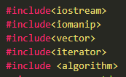
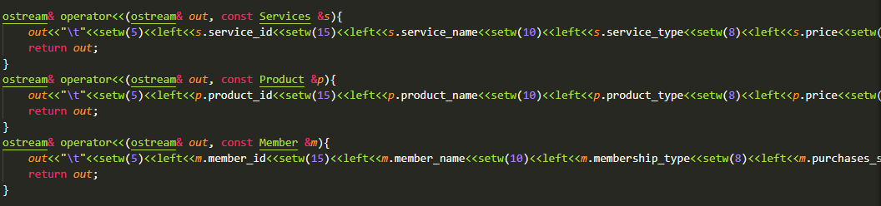
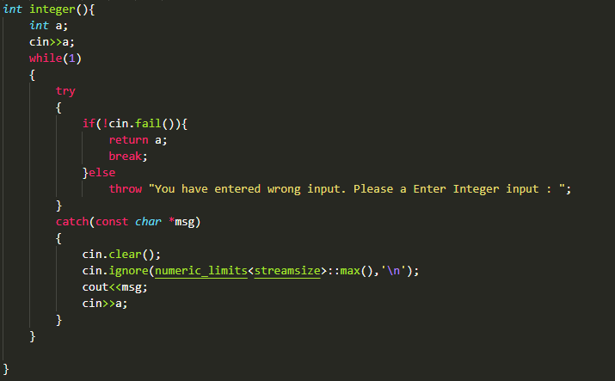
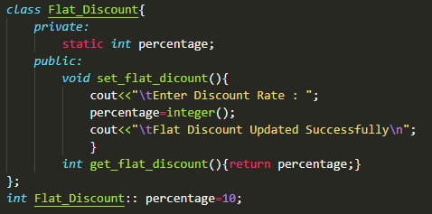
Some Important Code of Final Project
Header File
Operator Overloading
Flat Discount Class
Valid Data (integer) function

Slide 9
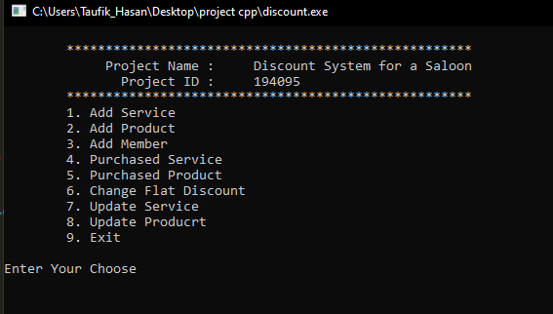
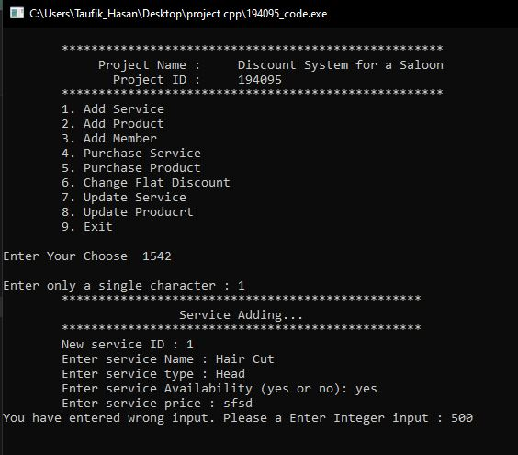
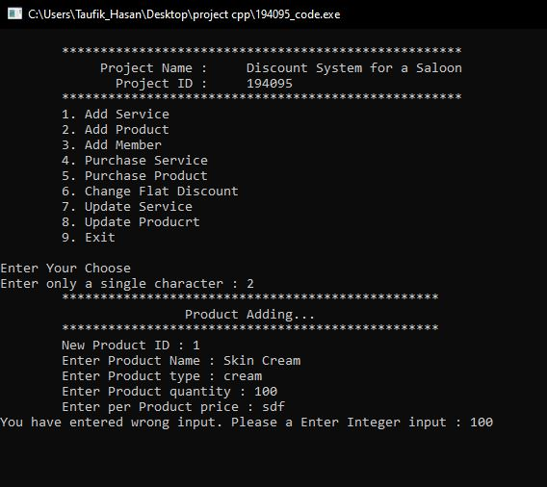
Final Project Output Interface
Main Interface
Before confirmation Interface
Service add Interface
Product add

Slide 10
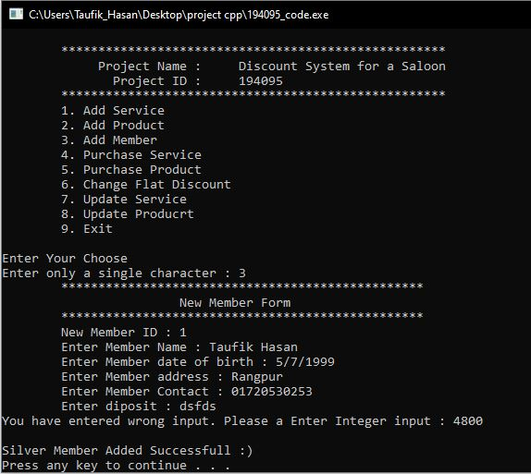
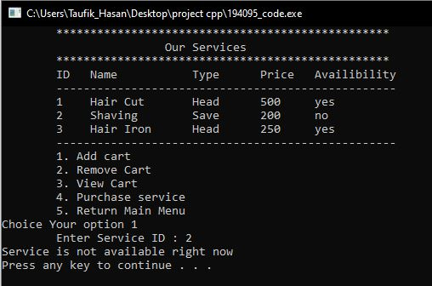
Final Project Output Interface
Member add
Purchase service

Slide 11
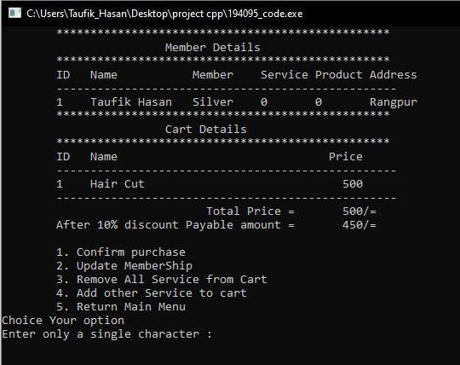
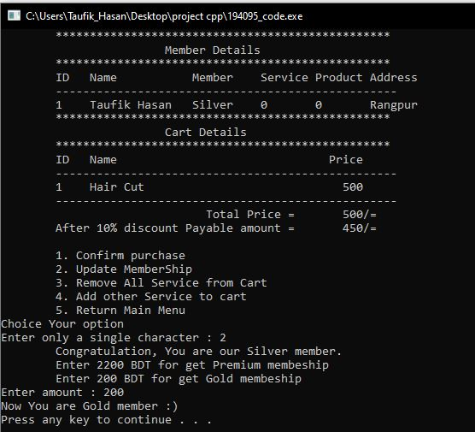
Final Project Output Interface
Purchase service
Purchase service

Slide 12
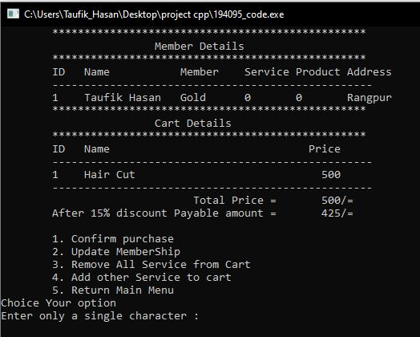
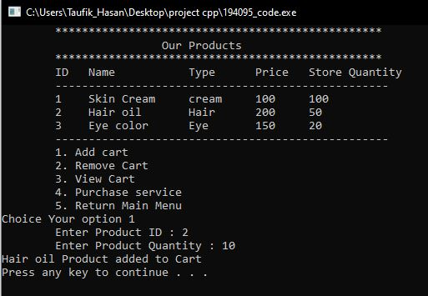
Final Project Output Interface
Purchase service
Purchase product

Slide 13
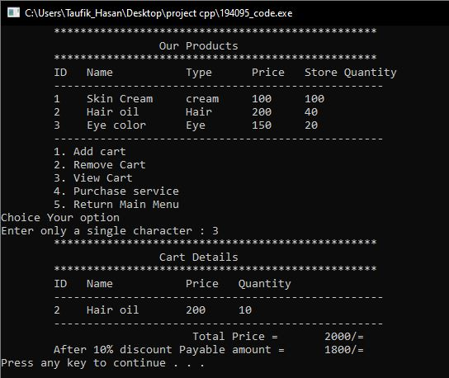
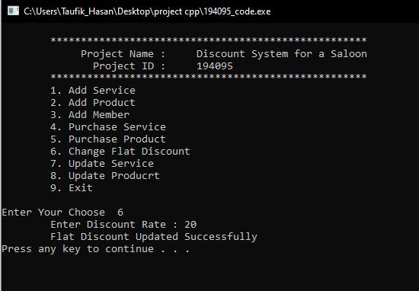
Final Project Output Interface
Purchase service
Change flat discount

Slide 14
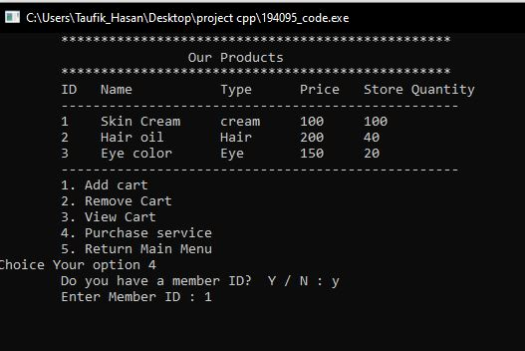
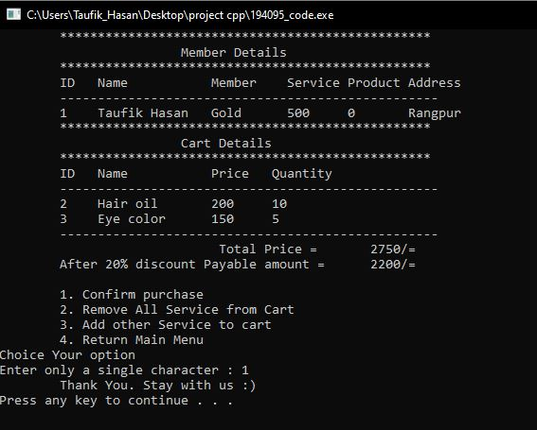
Final Project Output Interface
Purchase product
Product purchase

Slide 15
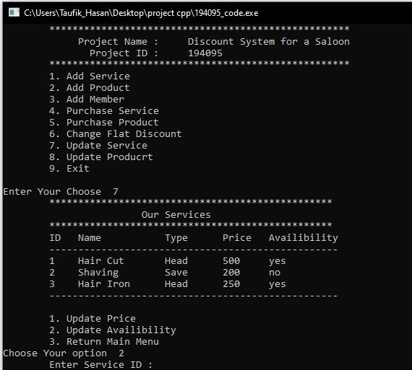
Final Project Output Interface
Update service

Slide 16

In this project I use :
In this project I use :
In this project I use :
Object Oriented Concept.
Operator Overloading.
Class, object.
Exception Handling.
Virtual class.
Vector.
Inheritance.
Iterator.
Friend function.
Function Overloading.
Q
Questions

Slide 17
In this project I use :
In this project I use :
In this project I use :
Object Oriented Concept.
Operator Overloading.
Class, object.
Exception Handling.
Virtual class.
Vector.
Inheritance.
Iterator.
Friend function.
Function Overloading.
Q
Questions

Slide 18
Thank You
THE END

